Slide 1
Henry Moseley
By Cherand Hardon, Demontez Watts-Burnett, Khalonji Gibbs, Taya

Slide 2
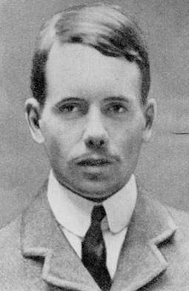
Who is Henry Moseley?
born November 23, 1887 and died August 10, 1915
Killed by a Turkish sniper in World War I

Slide 3
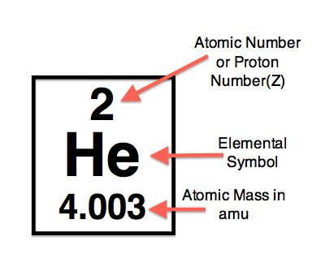
What did he discover?
Moseley developed the modern concept of the
atomic number.

Slide 4
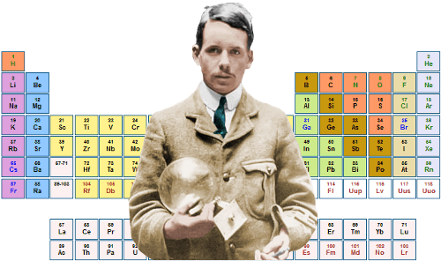
How Moseley changed the model of the atom?
Moseley supplied very valuable evidence that this rule (atomic numbers changing by one from element to element) also holds for a number of the lighter elements.
Moseley has shown that the variation of wavelength can be simply explained by supposing that the charge on the nucleus increases from element to element by exactly one unit.

Slide 5
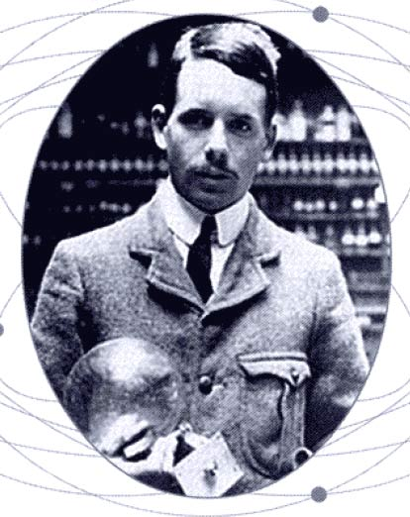
How He changed the Atom
Mosley devised a system that allowed him to study the x-ray diffraction pattern produced by one element in an orderly and efficient arrangement.
mosley found that since each element could be assigned to its own unique atomic number any missing numbers missing must mean that an element remains to be discovered for this particular position in the periodic table.
Moseley created the modern version of the periodic table based on atomic number rather than atomic weight.
Moseley found that when elements were arranged according to their atomic numbers.
Moseley accomplished groundwork for a lot of later development.

Slide 6
