Slide 1
History Of The Atomic Theory
J.J Thomson

Slide 2
JJ Thomson's Experimental Design
One of Thomson's experimental design was the cathode rays. The cathode rays were deflected by both the magnetic and electrical fields. Then measuring the angle at which the rays were deflected by such fields of any given magnitudes.
Thomson was also able to calculate the ratio of the electrical charge to the mass(e/m) for the particles that made up the rays. He also found that the value of (e/m) was the same for any gas used in the experiment.

Slide 3
Thomson’s Second Experiment
This consisted of two parts , one which was the newly discovered electron. But for his discovery he proposed a new model of the atom referred to as the “ plum pudding “ atom. The atom was thought to consist of a cloud of positive charge in which are embedded discrete electrons , much as individual plums are embedded in the traditional English plum pudding. The model was never successful , in the work if Thomson’s successor , Ernest Rutherford , a better atomic picture would soon evolve.

Slide 4
Evidence that led to a change
Thomson also extended his research to other phenomena caused by electrical discharges, such as the discharge from a negatively charged heated wire. He found an occurrence similar to that observed in original glass tube experiments, which particles with the same e/m ratio could be detected. He concluded that some fundamental particle with a e/m ratio was present in all of these experiments and , hence, was a component of all atoms.

Slide 5
More Evidence that led to a change
Because of that question, Thomson created better equipment such as vacuums to explain his answer to other researchers. He then developed another experiment that affected the cathode rays.
In the end, J.J Thomson showed the other researchers that the theory of the atom being invisible and a mass of material wasn’t correct. He proved that this was untenable and the atom must be made of two parts.

Slide 6
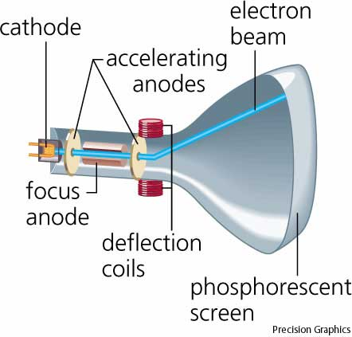
Changing The Atomic Model
Darwin inferred that the atom was invisible and had no particles inside. J.J Thomson proved that electrons exist and that atoms are not invisible. He did this by using the experiment with the Cathode Ray Tube to show that they had electrons. He showed that it must have at least two parts, one of which is the newly discovered electron, therefore it is not invisible.

Slide 7
